Slide 1
More ways to debug
Review of Classes
Dale/Weems/Headington

Slide 2
How to write a program
Top Down design
Write the main first
  Should be an outline of the program
  Leave the details until later.
  Input/output oriented
  Need variable(s) for the input
  Need variable(s) for the output

Slide 3
Lets write a program with class
Time Program
Given 2 times (and dates) find the difference between them.
Input (2 of them) Year, Month, Day, hour, minute, sec
Output with Year, Month, Day, hour, minute, sec (for the difference)

Slide 4
Class
class Time{
int year;
int month;
int day;
int hour;
int min;
int sec;
};

Slide 5
Break points
In all Integrated Development Environments (IDEs) one can set break points.
In Visual Studio click on the gray next to a line.
If you choose Debug -> Start Debugging
Your code will stop when you reach that point

Slide 6
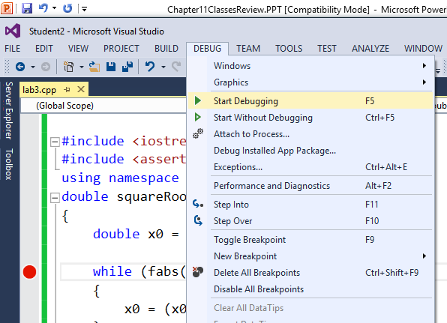

Visual Studio Break point

Slide 7
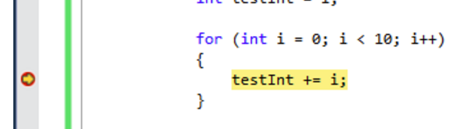
Stopping at a break point
Then you can step through your code (run 1 line at a time and look at the variables)
When it stops the line is colored yellow(it stops before the yellow line)

Slide 8
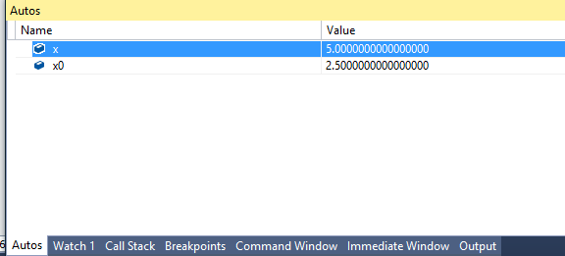
At the break
At the break you can examine the values of variables
Can choose AUTO or set watches

Slide 9
Another way to stop execution
Pre/post conditions are just comments
Pre conditions can be implemented with assert(boolean expression)
#include <assert.h>
Then your code will stop if it hits an assert and the condition fails

Slide 10
Software Engineering
Test cases

Slide 11
For Each Test Case:
Determine inputs.
Determine the expected behavior of the program.
Run the program and observe the resulting behavior.
Compare the expected behavior and the actual behavior.
expanded by J. Goetz

Slide 12

Program Verification
Program Verification is the process of determining the degree to which a software product fulfills its specifications.
SOFTWARE SPECIFICATIONS
Inputs
Outputs
Processing
Requirements
Assumptions
PROGRAM
expanded by J. Goetz

Slide 13
Types of Errors
Specification
Design i.e. occurs when specifications are wrong
Coding
  Compile Time Errors
  Run Time Errors – the hardest to prevent & locate
Input – handler – request new input, print a message or go on to the next data).
  If worse comes to worst, let your program die gracefully.
expanded by J. Goetz

Slide 14
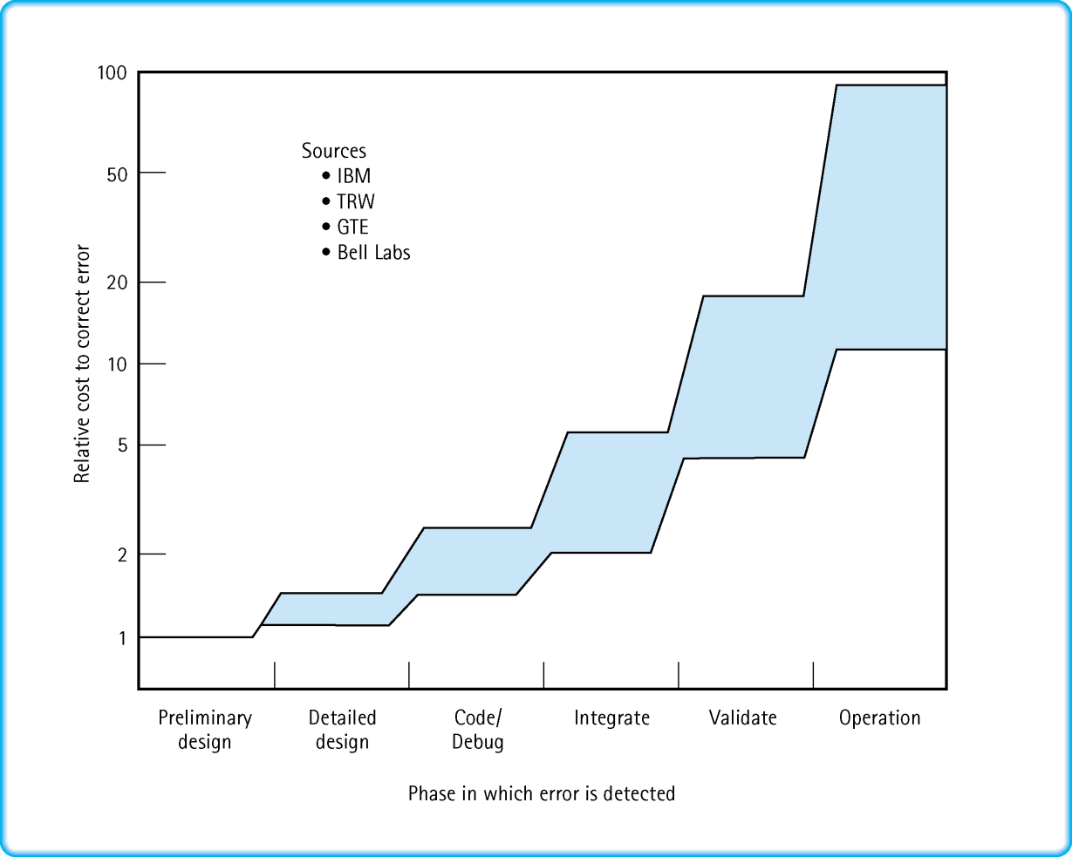
Cost of a Specification Error Based on When It Is Discovered
expanded by J. Goetz

Slide 15
BASIC PRINCIPLE
A basic principle about software costs:
  The earlier in the development cycle a problem is detected, the cheaper it is to fix.
expanded by J. Goetz

Slide 16
EXPERT KNOWLEDGE
It is worthwhile to develop an expert knowledge of both
  The control and data structures
  The syntax of the language
expanded by J. Goetz

Slide 17
Robustness
Robustness is the ability of a program to recover following an error; the ability of a program to continue to operate within its environment.
It is generally unwise to make too many assumptions about the correctness of input
  check explicitly for the correct type and bounds of such input
  Decide how an error should be handled
    request new input,
    print a message, or
    skip this input
  Some run-time errors
    Swapped 2 parameters of the same type on a function call,
    Forgot to designate a function’s output data as a reference parameter
expanded by J. Goetz

Slide 18
An Assertion
Is a logical proposition that is either true or false (not necessarily in C++ code).
EXAMPLES
studentCount is greater than 0
sum is assigned && count > 0
response has value ‘y’ or ‘n’
partNumber == 5467
We use preconditions and postconditions at the module level or function level because it helps us to design programs in a truly modular fashion.
expanded by J. Goetz

Slide 19
Preconditions and Postconditions
The precondition is an assertion describing what a function requires to be true before beginning execution.
The postcondition describes what must be true at the moment the function finishes execution.
The caller is responsible for ensuring the precondition, and the function code must ensure the postcondition.
FOR EXAMPLE . . .
expanded by J. Goetz

Slide 20
void PrintList ( ofstream& dataFile, UnsortedType list)
// Pre: // dataFile is open for writing.
// Post: Each component in list has been written to dataFile.
// dataFile is still open.
{ using namespace std;
int length;
ItemType item;
list.ResetList();
length = list.LengthIs();
for (int counter = 1; counter <= length; counter++)
{
list.GetNextItem(item);
item.Print(dataFile);
}
}
expanded by J. Goetz

Slide 21
Another Example
void Getroots (float a, float b, float c,
float& root1, float& root2 )
// Pre: a, b, and c are assigned.
// a is non-zero, b*b - 4*a*c is non-negative.
// Post: root1 and root2 are assigned
// root1 and root2 are roots of quadratic with coefficients a, b, c
{
using namespace std;
float temp;
temp = b * b - 4.0 * a * c;
root1 = (-b + sqrt(temp) ) / ( 2.0 * a );
root2 = (-b - sqrt(temp) ) / ( 2.0 * a );
return;
}
expanded by J. Goetz

Slide 22
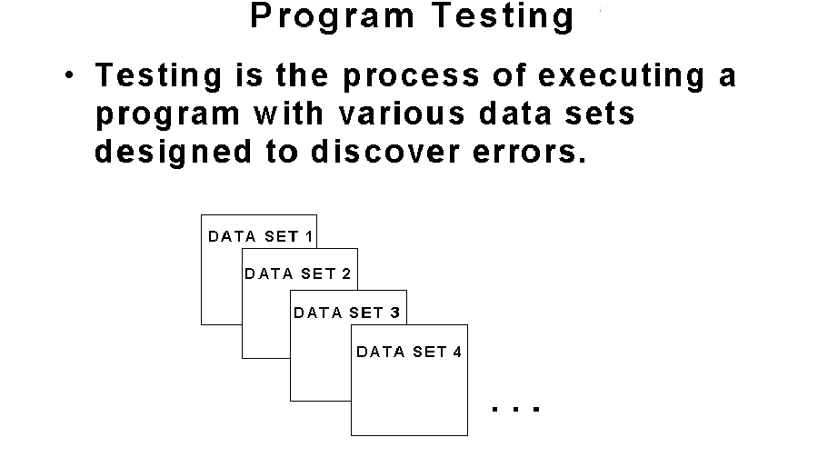
Program Testing
expanded by J. Goetz

Slide 23
Testing
Testing Selection Control Structures
  to test a program with branches, use enough data sets so that every branch is executed at least once
  this is called minimum complete coverage
Unit testing. Testing a class or function by itself
expanded by J. Goetz

Slide 24
Testing Often Combines Two Approaches
WHITE BOX BLACK BOX
TESTING TESTING
Code Coverage
Allows us to see the
program code while
designing the tests.
Ensure that each statement in the program is executed at least once.
We could say that 75% of the branches of a program have been executed or 50% of the path have been tested (metric based testing).
Data Coverage
Data values at
the boundaries, and
possibly middle values,
example of each category of inputs can be tested.
Cover general classes of data – every possible data input is too large
expanded by J. Goetz

Slide 25
// Code Coverage example p.40
#include <iostream>
void Divide(int, int, bool&, float&);
// Function to be tested.
void Print(int, int, bool, float);
// Prints results of test case.
int main()
{
using namespace std;
bool error;
float result;
int dividend = 8; // Test 1
int divisor = 0;
Divide(dividend, divisor, error, result);
cout << "Test 1: " << endl;
Print(dividend, divisor, error, result);
divisor = 2; // Test 2
Divide(dividend, divisor, error, result);
cout << "Test 2: " << endl;
Print(dividend, divisor, error, result);
return 0;
}
void Divide(int dividend, int divisor, bool& error, float& result)
// Set error to indicate if divisor is zero.
// If no error, set result to dividend / divisor.
{
if (divisor = 0)
error = true;
else
result = float(dividend) / float(divisor);
}
expanded by J. Goetz

Slide 26
Data Coverage Test Plan p.41
Debugging p.43
Add output statements that indicate when you are entering and leaving each function
expanded by J. Goetz

Slide 27
void Divide(int dividend, int divisor, bool& error, float&
result)
// Set error to indicate if divisor is zero.
// If no error, set result to dividend / divisor.
{
using namespace std;
// For debugging
cout << "Function Divide entered." << endl;
cout << "Dividend = " << dividend << endl;
cout << "Divisor = " << divisor << endl;
//*************************
// Rest of code goes here.
//*************************
// For debugging
if (error)
cout << "Error = true ";
else
cout << "Error = false ";
cout << "and Result = " << result << endl;
cout << "Function Divide terminated." << endl;
}
expanded by J. Goetz

Slide 28
Tasks within each test case p.39:
determine inputs that demonstrate the goal.
determine the expected behavior for the input.
run the program and observe results.
compare expected behavior and actual behavior. If they differ, we begin debugging.
expanded by J. Goetz

Slide 29
How to Test a Program
design and implement a test plan
a test plan is a document that specifies the test cases planned for a program or module, which includes
  purposes
  conditions of the test cases inputs,
  and the expected output
implement the test plan by verifying that the program outputs the predicted results
expanded by J. Goetz

Slide 30
Test Plan to determine the intersection of 2 lines input format: m1 x1 y1 m2 x2 y2
Purpose of the test | Input (slope and a pt of each line) | Expected output | Actual output
min boundary case | 0 0 0 1 0 0 | (0,0) | (0,0)
Max boundary case | 9999 0 0 1 0 0 | (0,0) | (0,0)
The lines intersect | 2 0 0 3 0 0 | (0,0) | (0,0)
The lines are parallel | 2 1 2 2 0 0 | no intersection | no intersection
The lines are collinear | 2 0 0 2 1 1 | (0,0) | (0,0)
One line has infinite slope | n/a | n/a | n/a
One line has zero slope | 2 0 0 0 0 0 | (0,0) | (0,0)
expanded by J. Goetz

Slide 31
Equivalence Partitioning
To avoid unnecessary testing, partition (divide) the range of inputs into groups of equivalent tests.
Two tests are equivalent if they are so similar to each other that it is pointless to test both.
Select an input value from the equivalence class as representative of the full group.

Slide 32
Example
Sum program (these are all the same test)
  Test 1 1 + 2
  Test 2 1000 + 2000
  Test 3 100000 + 200000
  Test 4 -1 + -2

Slide 33
Boundary Testing
Behavior at the edge of equivalence partition is more likely to be incorrect
Test max and min values of a paritition

Slide 34
Risk Based Testing
Imagine how the program could fail
Design test cases to expose these (potential failures)

Slide 35
Test Plans
For program testing to be effective, it must be planned.
Start planning for testing before writing a single line of code.
expanded by J. Goetz

